Slide 1
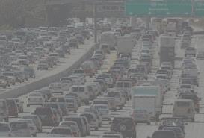
Regional Consequences of Climate and Land Use Change on Ecosystem Services in Pennsylvania
Benjamin Felzer

Slide 2
Outline of Talk
Introduction: Environmental Stresses and Ecosystem Services
Description of Tools: Models and Data
Model Validation
Role of climate and land use change in PA
Future climate extremes and flooding in the Lehigh Valley
Historical Multiple Factorial Effects in the Mid-Atlantic

Slide 3
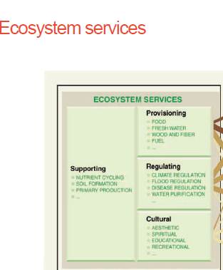

Slide 4
Environmental Stresses
Rising atmospheric CO₂
Climate variability and change
Land use cover and change
Nitrogen deposition and fertilizer
Ozone near surface

Slide 5
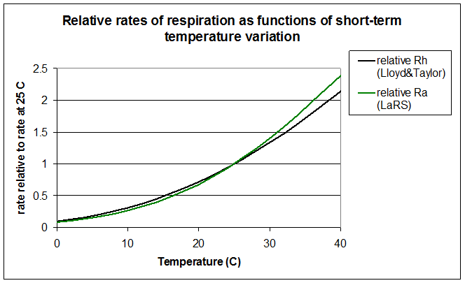
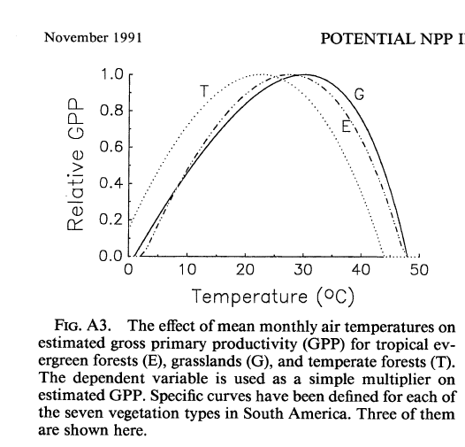
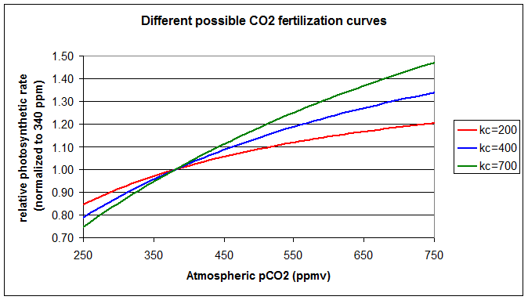
CO₂ and Climate
(Raich et al., 1991)

Slide 6
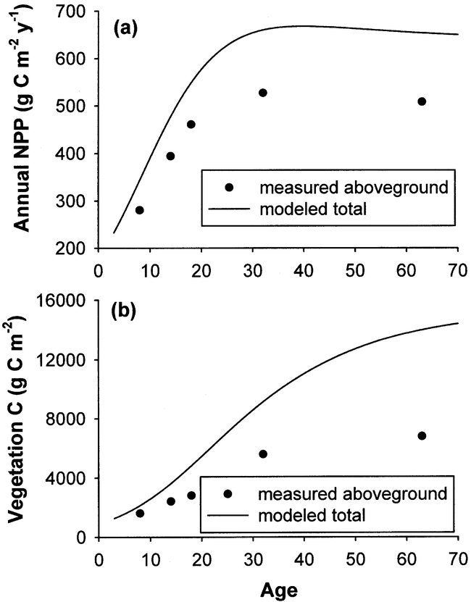
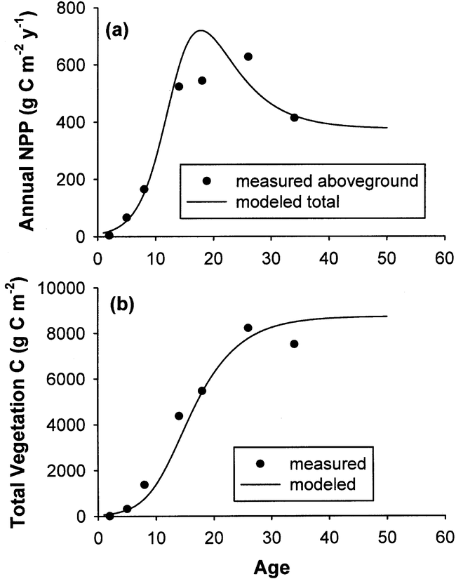
Forest Regrowth
Poplar, WI
Pine, FL
(Pan et al., 2002)

Slide 7
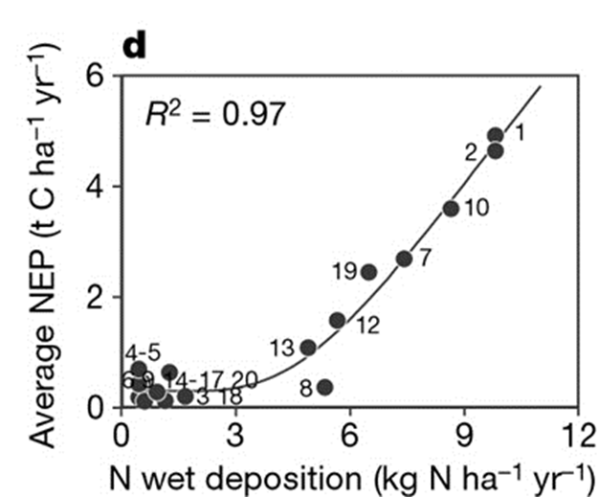
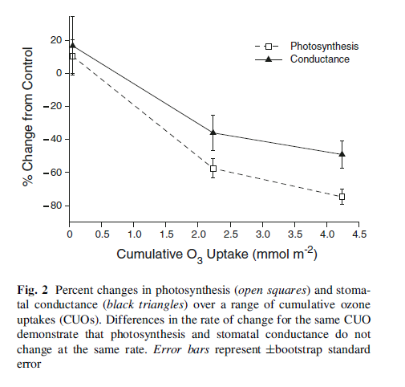
Nitrogen and Ozone
Tulip Poplar
(Magnani et al., 2007)
(Lombardozzi et al., 2012)

Slide 8
Carbon Accounting
Net Ecosystem Productivity (NEP) = NPP – r_{h}
where NPP = Net Primary Productivity
r_{h} = heterotrophic respiration
Net Carbon Exchange (NCE) = NEP – e_{c} – e_{p}
    where e_{c} = carbon lost due to conversion
    e_{p} = carbon lost due to decomposition of products
    Positive NEP, NCE means land is carbon sink
    Generally neutral (Odum, 1969) or small sink (Luyssaert et al., 2008) or small source (Law et al. 2004) for mature forest.

Slide 9
Description of Tools: Models and Data
Biogeochemical Model (TEM-Hydro)
Climate Data
Land Cover Data

Slide 10
TEM-Hydro Model
Atmosphere
Water
Carbon
Transp.
GPP
Rg
Rm
Rh
Vegetation
Precip.
Carbon
LTRC
Nitrogen
Soil Evap.
N uptake
LTRN
Water
Nitrogen
Carbon
Soil
Runoff
(Felzer et al, 2009, 2011)
Notes:
Figure 3: TEM-Hydro overview. TEM-Hydro considers interactions between the atmosphere, vegetation, and soil. Carbon fluxes between the atmosphere and vegetation include GPP (gross primary productivity) and growth and maintenance respiration (Rg, Rm). LRTC and LTRN are the carbon and nitrogen litterfall rates, respectively, from vegetation to soil. Heterotrophic respiration (Rh) represents microbial soil decomposition, and Nuptake represents the uptake of inorganic nitrogen from the soil. Soil evaporation and plant transpiration are considered separately. The carbon and nitrogen in vegetation is further divided between four structural pools (fine roots, leaves, sapwood, and heartwood), and a labile pool for storage (see text).

Slide 11
Disturbance
Cohort Approach
Slash: input to soils
Residue: to atmosphere
Product Pools (1, 10, 100 years): decomposition rates
Open Nitrogen
Inputs: N fixation, N deposition, N fertilizer
Outputs: Leaching of Dissolved Organic Nitrogen (DON) and Dissolved Inorganic Nitrogen

Slide 12
Inputs and Calibration
Climate (Cloud or Radiation, Temperature, Precipitation, ozone, carbon dioxide (global annual value))
Vegetation Cohorts
Soil and Elevation (static)
Calibration of carbon and nitrogen parameters to target values of carbon and nitrogen stocks and fluxes

Slide 13
Climate Data
Dataset | Spatial Res. | Temporal Res. | Time Period | Scenario
CRU | 0.5º | Monthly | 1901-2009 | historical
PRISM | 1/24º | Monthly | 1890-2013 | historical
CMIP3 (Maurer) | 1/8º | Monthly | 1950-2099 | A2, A1B, B1

Slide 14
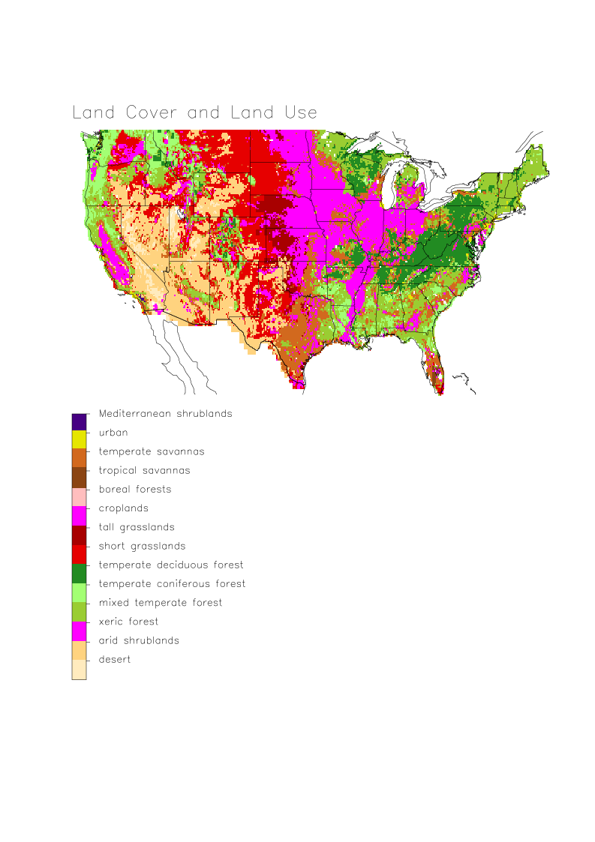
Notes:
Figure 3: Land use and land cover change, based on 1981-1994 1 km Land Cover Classification Dataset scaled to TEM vegetation categories.

Slide 15
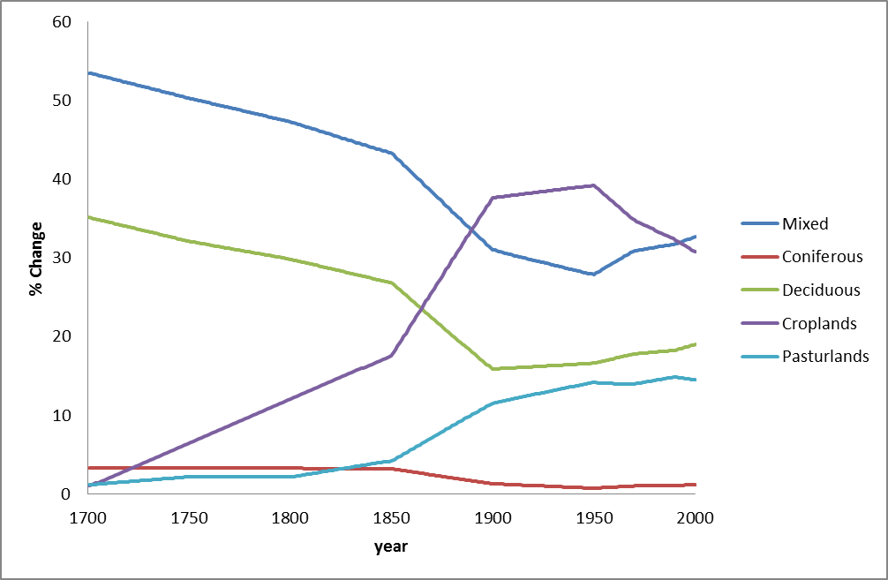
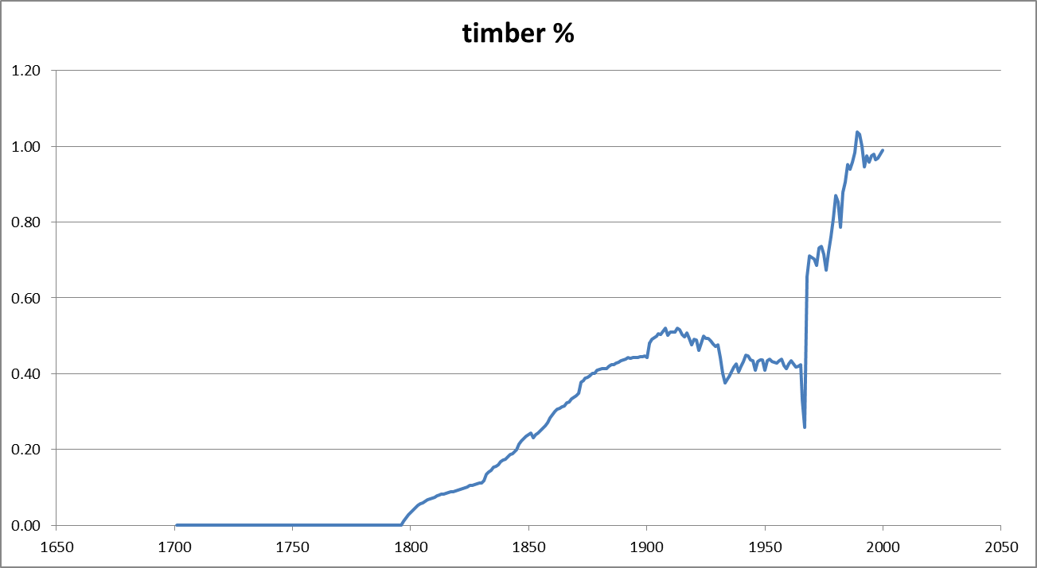
Hurtt Dataset

Slide 16
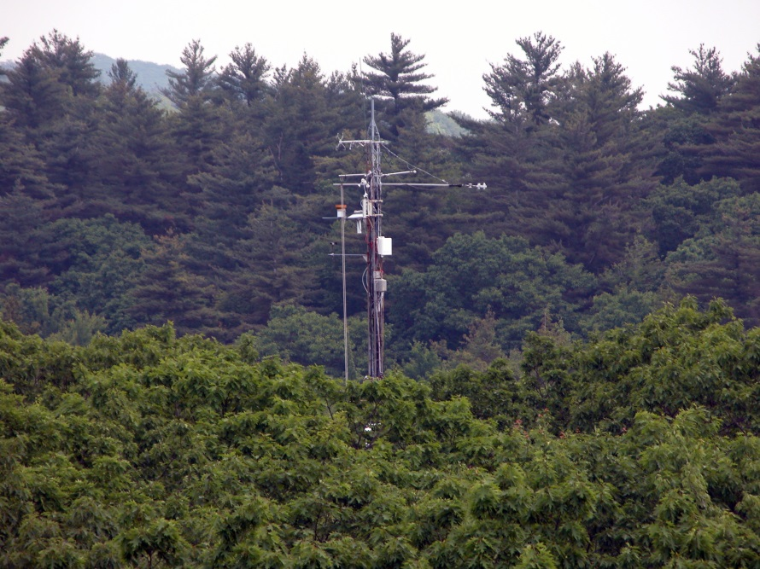
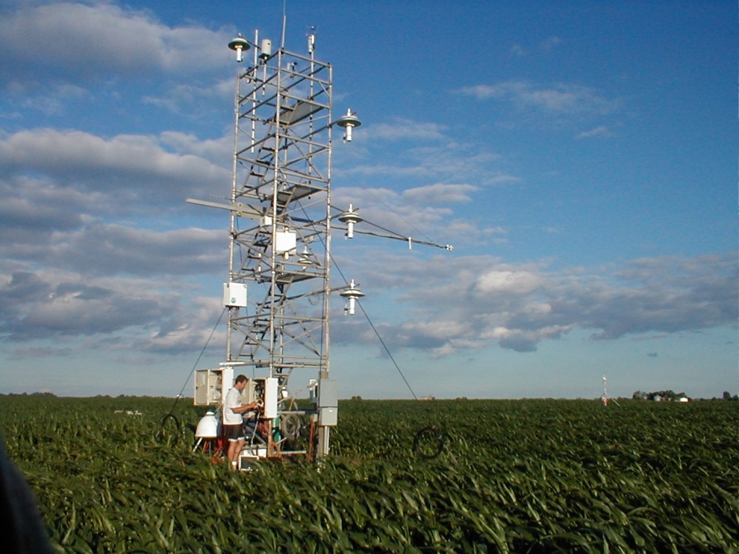
Model Validation
Streamflow at Watersheds
Eddy Covariance (Ameriflux) NEE (Net Ecosystem Exchange) and ET (Evapotranspiration)
Gridded Datasets combining Eddy Covariance and Remote Sensing (EC-MOD, Fluxnet-MTE)

Slide 17
Eastern U.S. Forests
(Felzer et al., 2009)
Notes:
Figure 4: Scatter plot of modeled evapotranspiration (ET) vs. observed ET calculated as the difference between precipitation (from the Climatic Research Unit [Mitchell et al., 2003]) and runoff (from the USGS river gauge data) in mm yr⁻¹ for the period 1970-1999 for the 12 watersheds used in this study

Slide 18
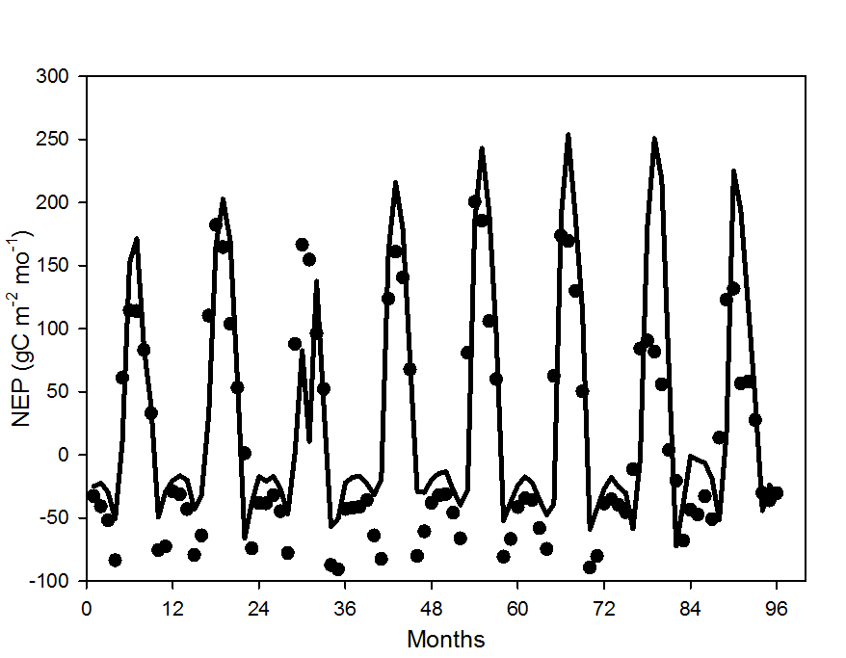
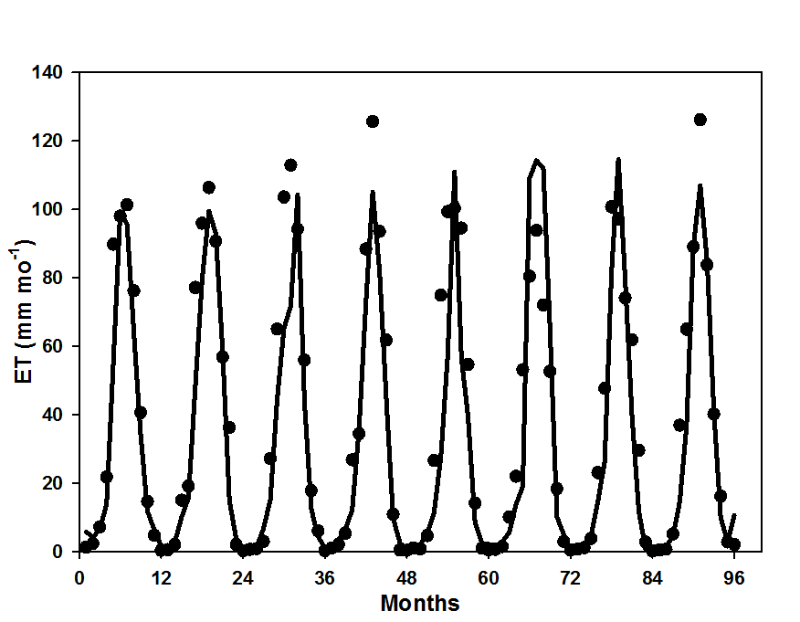

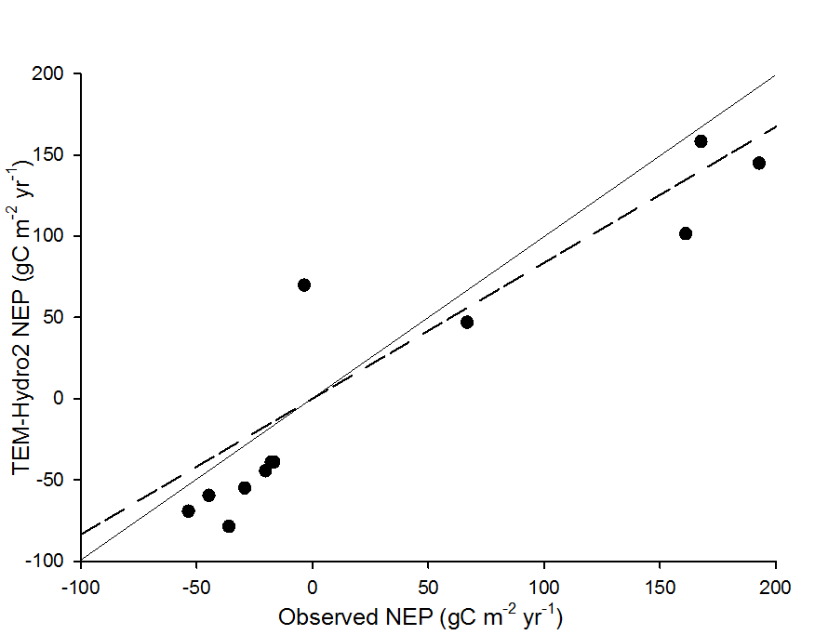
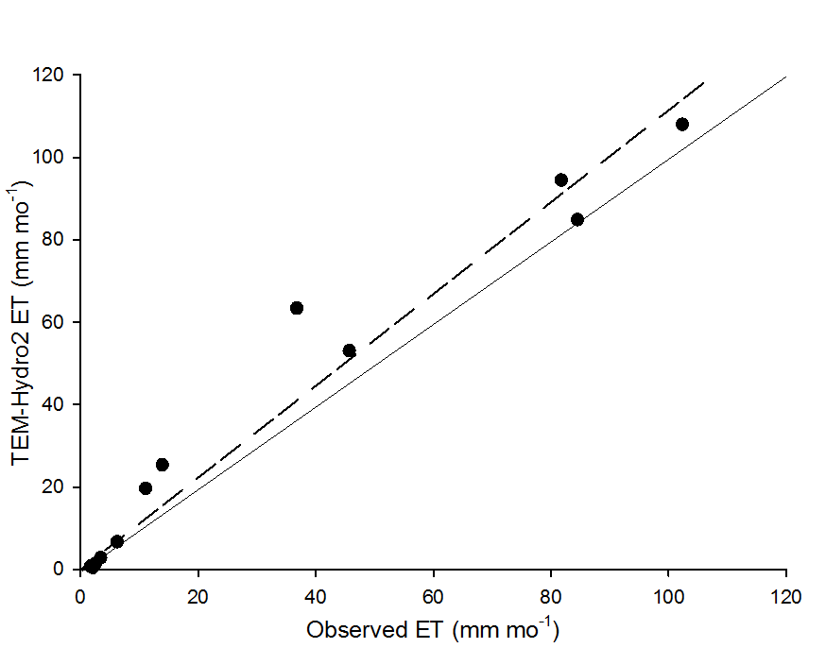

Willow Creek, WI
(a)
(b)
(c)
(d)
Notes:
S3. Temporal patterns (1999-2006) of TEM-Hydro2 and eddy covariance estimates at Willow Creek, WI for (a) monthly NEP (m = 0.75, b = -13.84, R² = 0.70, p < 0.001) and (b) monthly ET ( m = 0.99, b = 5.78, R² = 0.87, p < 0.001); and comparison of TEM-Hydro vs eddy covariance for (c) average monthly NEP and (d) average monthly ET.

Slide 19
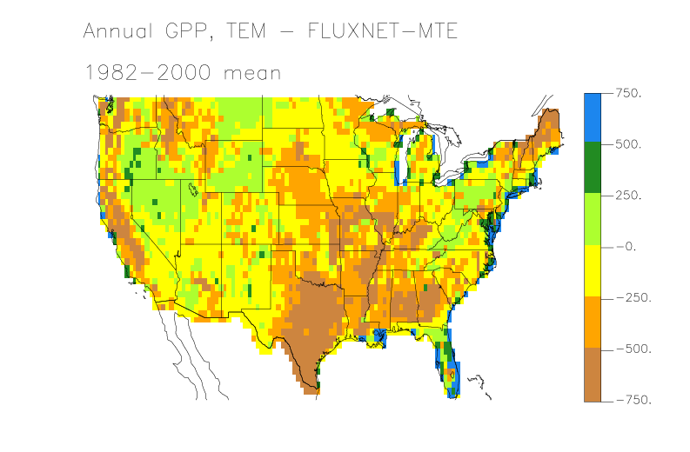
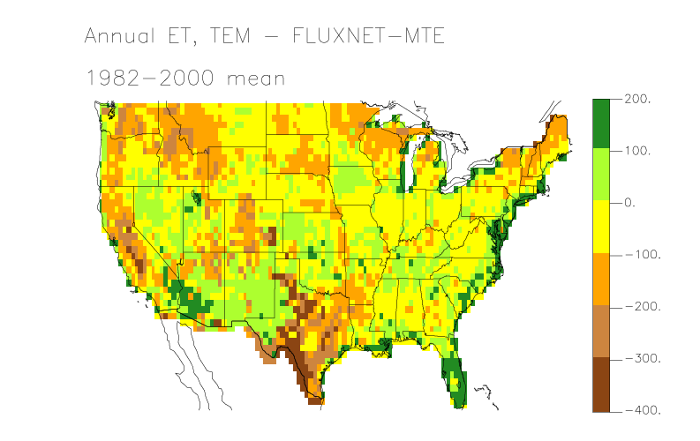
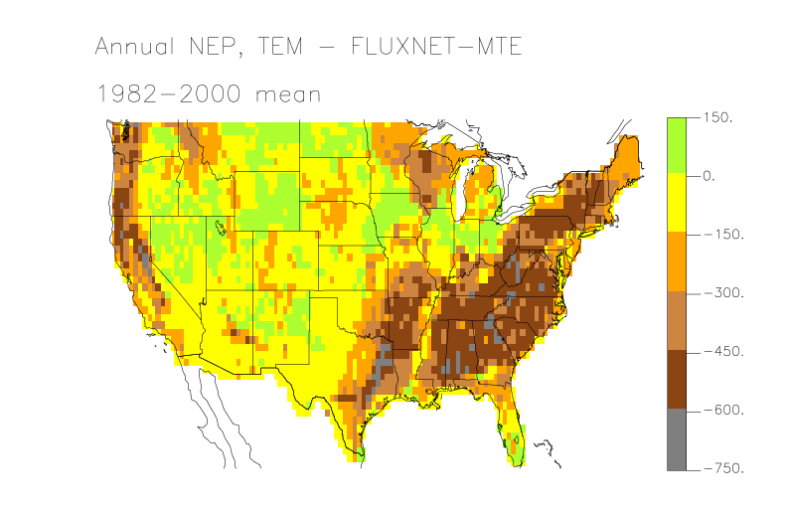
Validation: without land use disturbance
Felzer and Sahagian, Climate Research, in review
Notes:
Figure 4: a) Annual GPP, TEM-Hydro – FLUXNET-MTE, 1982-2000 mean, gC/m2/yr, b) Annual ET, mm H2O /m2/yr, c) Annual NEP, gC/m2/yr

Slide 20
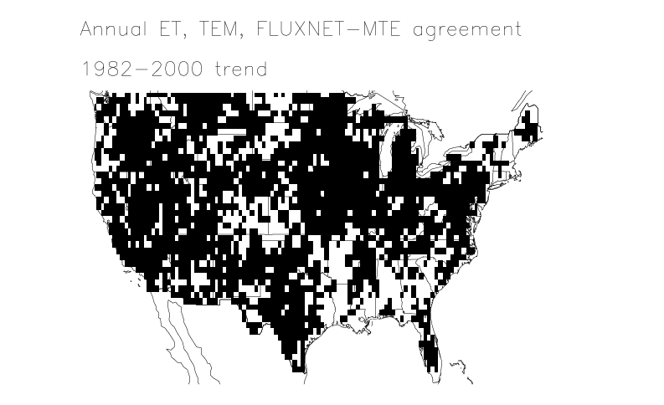
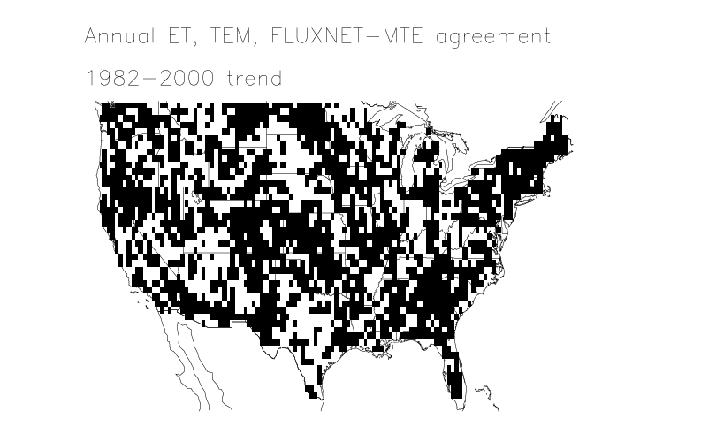
Trend Comparison: Evapotransporation
Accounting for significant, 72% grids
Not accounting for significant, 60% grids
Notes:
Figure 7: Agreement of trends between TEM-Hydro and FLUXNET-MTE for ET, Black = agreement a) accounting for significance, 72% of grids, b) not account for significance, 60% of grids. There are an additional 602 grids with same trend if not accounting for significance, equaling 91% of grids.

Slide 21
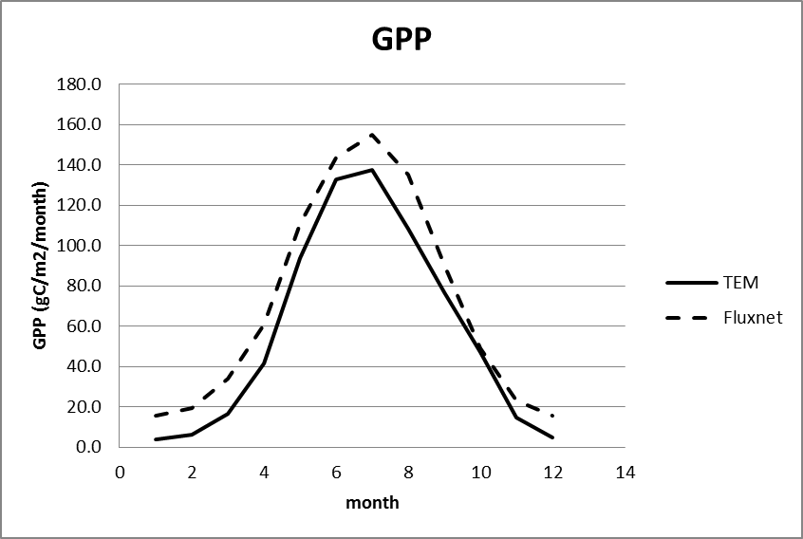
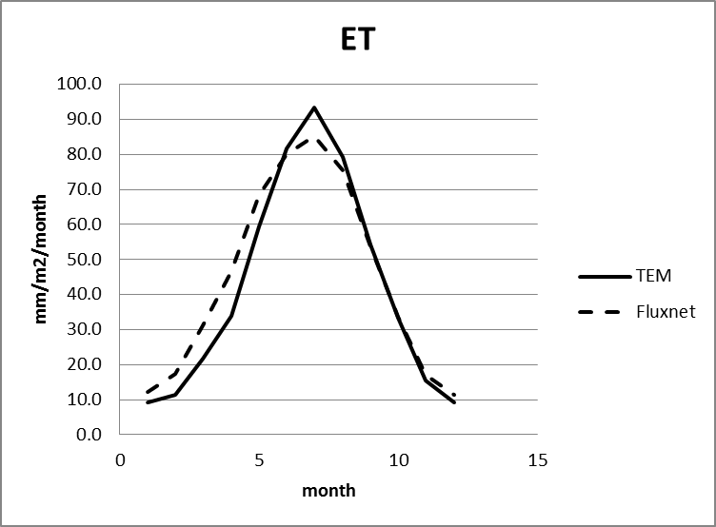
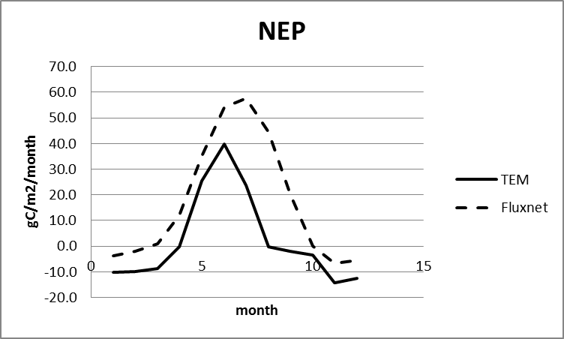
Seasonal Validation
Felzer and Sahagian, Climate Research, in review
Notes:
Figure 9: Seasonal trends between TEM-Hydro and FLUXNET-MTE, mean 1982-2000, a) GPP (gC/m2/yr) , b) ET (mm H2O/m2/yr) , c) NEP (gC/m2/yr).

Slide 22
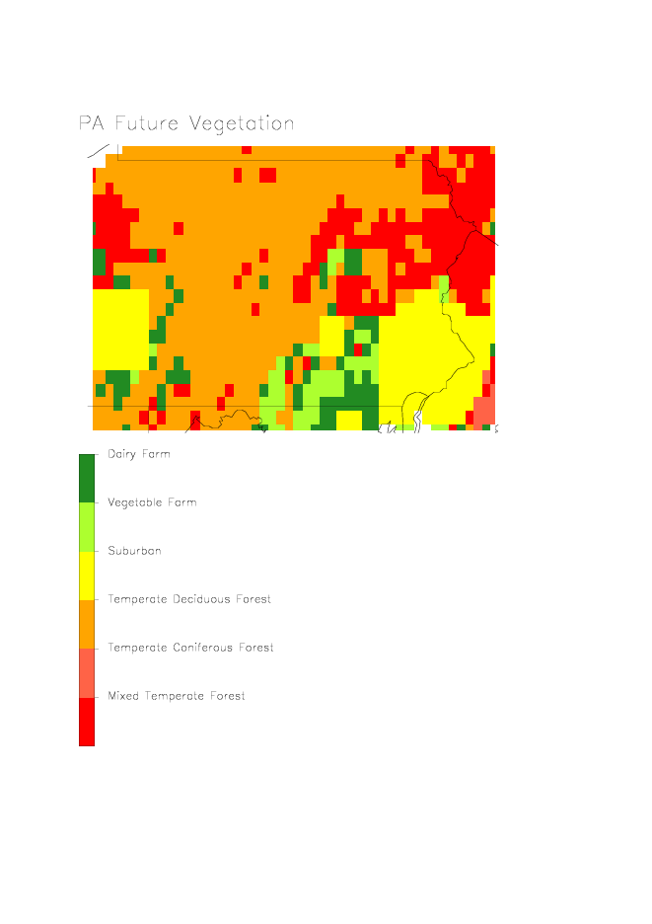
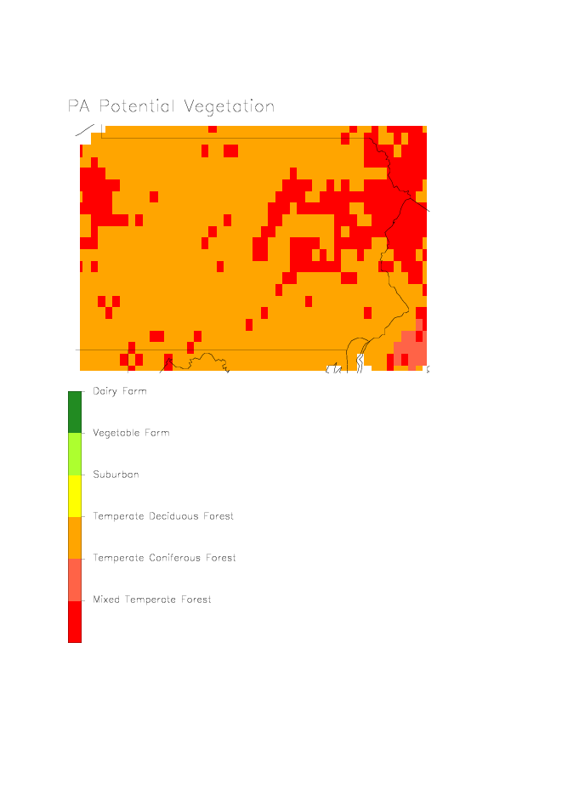
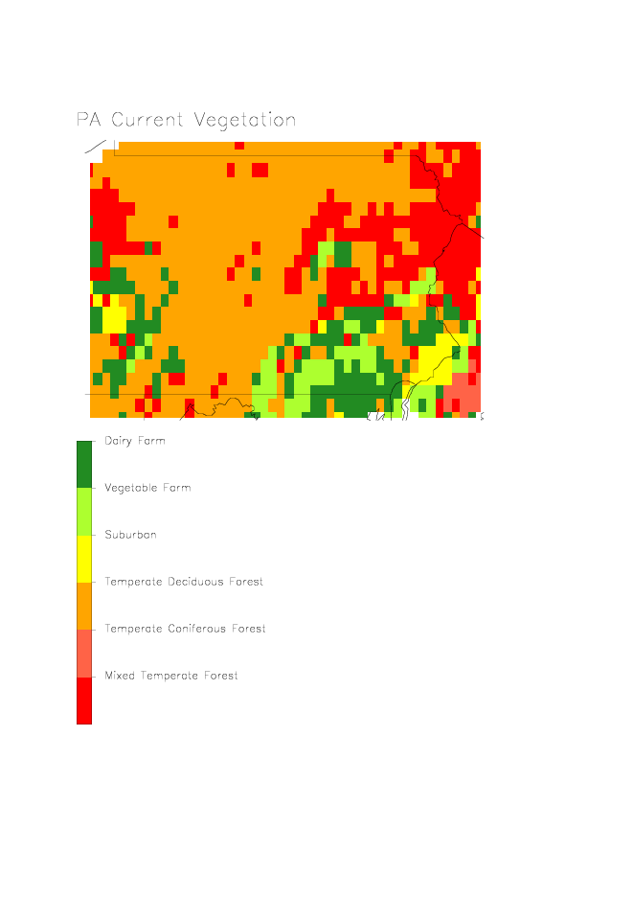
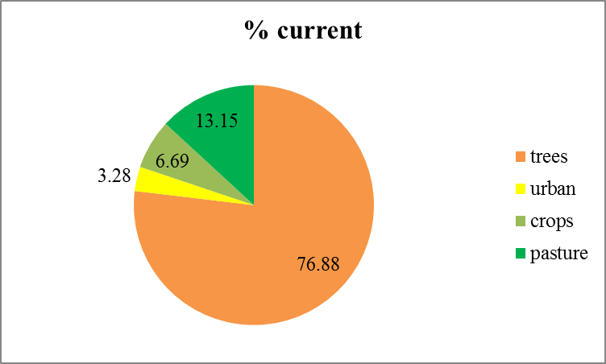
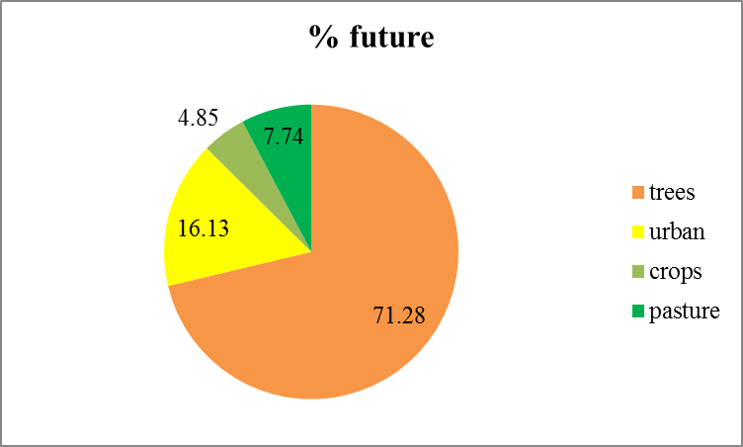
PA Study
(Felzer et al., 2012)
Notes:
Figure 3: Land use and land cover scenarios

Slide 23
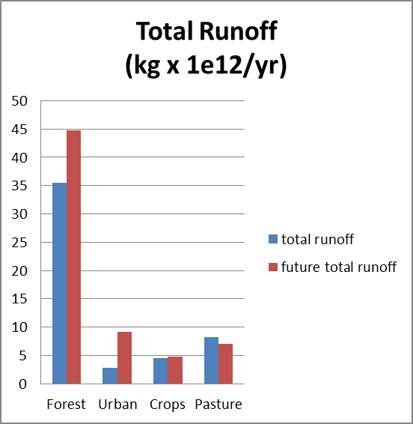
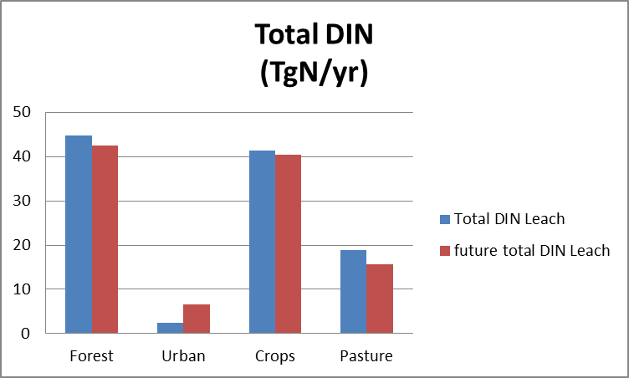
Note: Future is A2

Slide 24
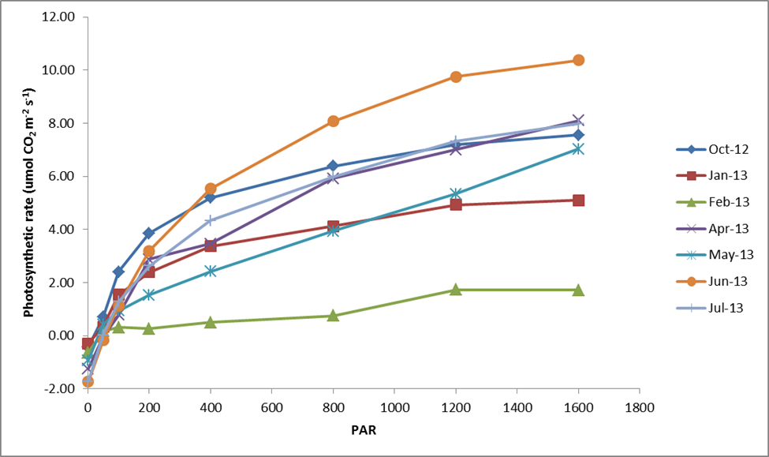
Rodale-based Dairy Farm Parameterization
(Jiang and Zhang, in prep.)

Slide 25




Measured Rodale dairy pasture targeting values
GPP: 1020 g C yr⁻¹ m⁻²
NPP: 466 g C yr⁻¹ m⁻²
Ra: 554 g C yr⁻¹ m⁻²
Rh: 1685 g C yr⁻¹ m⁻²
Vegetation C: 922 g C m⁻²
Vegetation N: 57.8 g N m⁻²
Available N: 3.3 g N m⁻² Soil C: 2559 g C m⁻² Soil N: 360 g N m⁻²

Slide 26
Flooding in Lehigh Valley
Historical NCDC storm statistic
Future bias-corrected NCAR CESM storm statistic
HEC-HMS peak stream discharge
Monocacy Creek
HEC-RAS
Flood
Profiles
(Felzer, Schneck, Withers, and Holland in preparation)

Slide 27
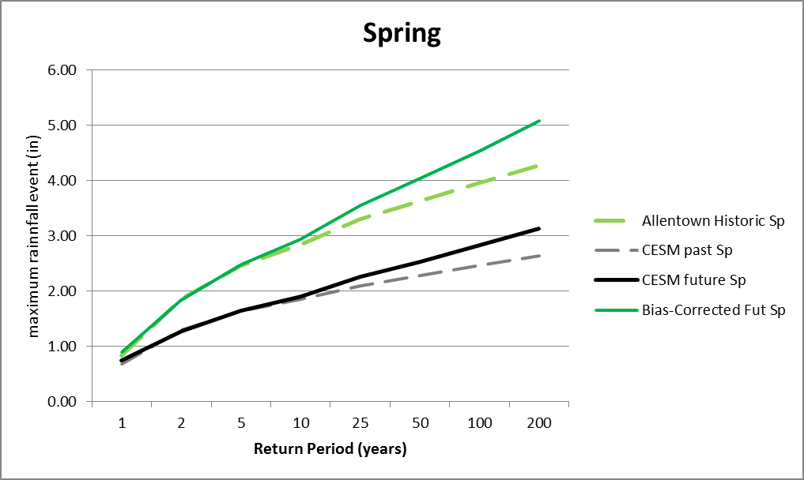
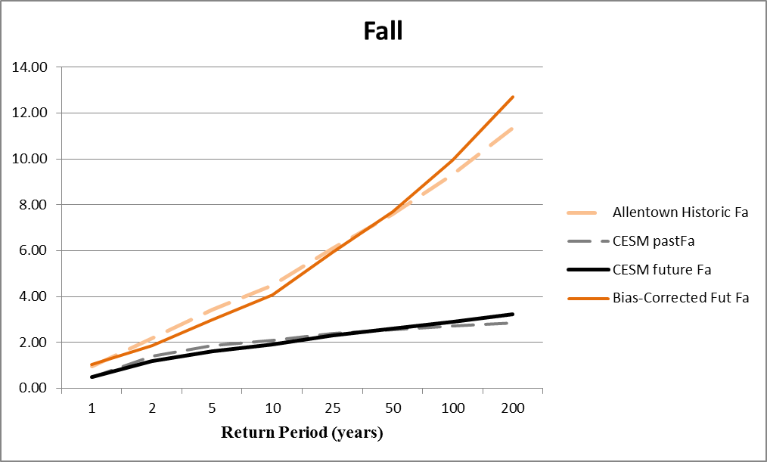
24 Hour Storm Event
(inches)

Slide 28
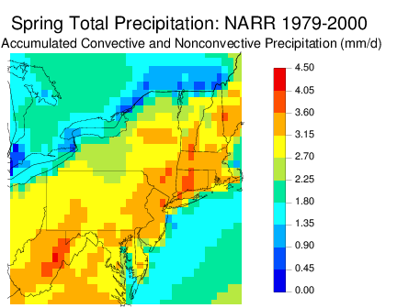
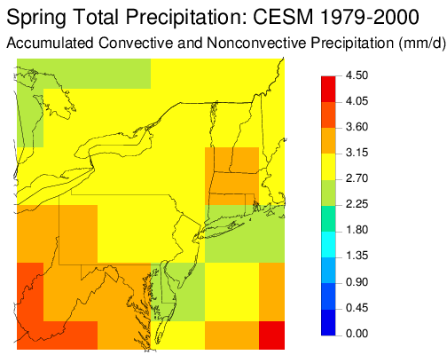
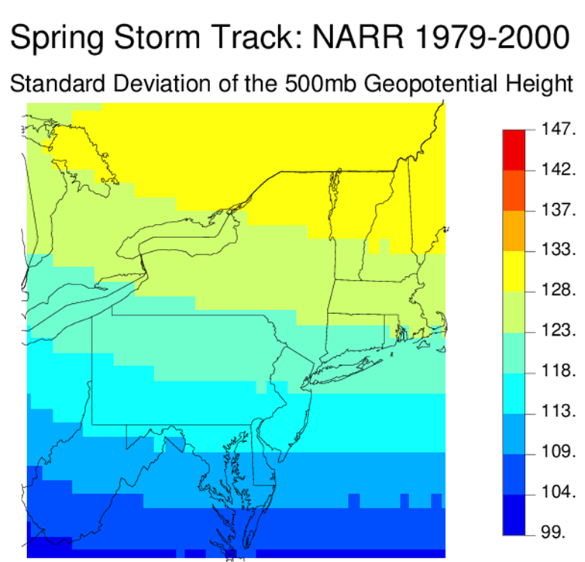
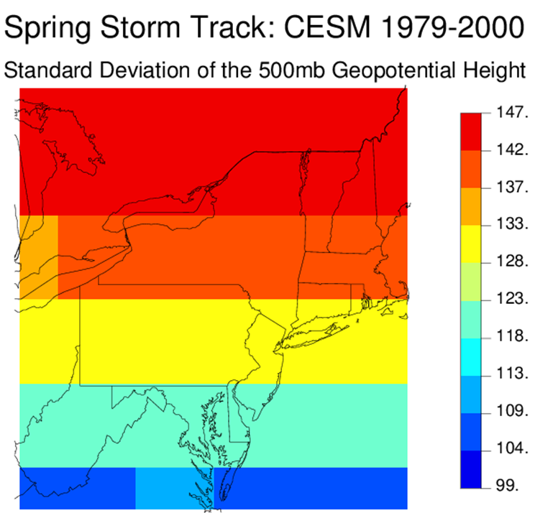
Notes:
CESM is lower

Slide 29
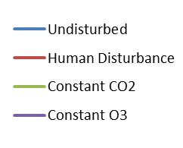
Effects of Human Disturbance on Carbon: Eastern U.S.
(Dangal et al., 2013)
Notes:
Figure 5: Cumulative modeled NCE for the Eastern US during the historical period (a) and 20th century (b). The anthropogenic-disturbed and undisturbed simulations represent simulation with and without anthropogenic disturbance, respectively; but with transient climate, CO₂, and ozone. Constant CO₂ is a simulation with human disturbance, transient climate, and transient ozone holding CO₂ constant at 280 ppmv, while constant O₃ is a simulation with anthropogenic disturbance, transient climate, and transient CO₂ with constant ozone.

Slide 30
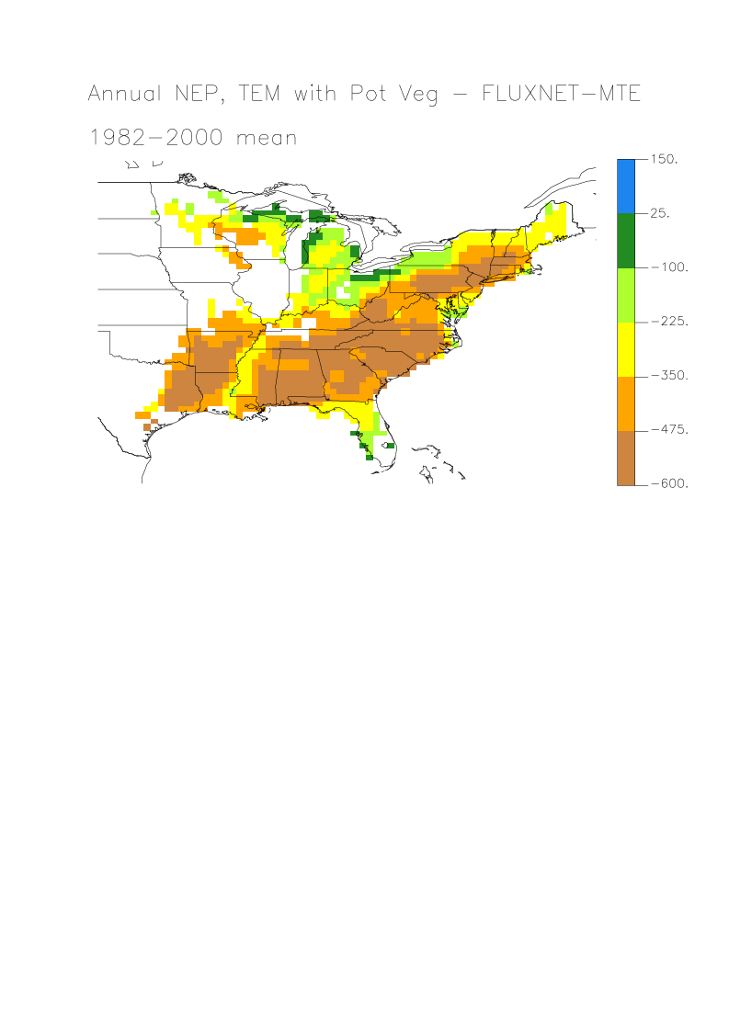
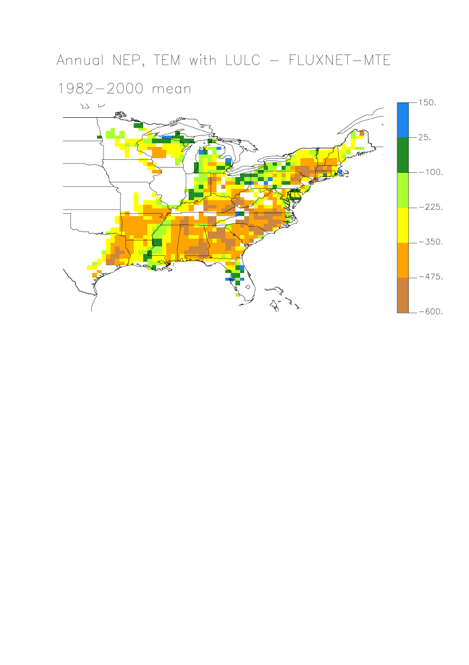
Net Ecosystem Productivity (NEP) Validation
Site ID | EC NEE | Biometric | DIST NEP | UND NEP | % diff. | RMSE | NC
DUK | 489 | NA | 321 | 140 | -34 | 54 | -0.67
WLK | 750 | 252 | 360 | 180 | -52 | 62 | 0.50
WIL | 360 | 106 | 150 | 50 | -58 | 59 | 0.60
UMBS | 170 | 73 | 189 | 80 | 11 | 61 | 0.51
(Table from Dangal et al., 2013)

Slide 31
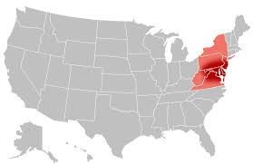
Multifactorial Experimental Design for MidAtlantic
 | LULC | CO₂ | Climate | O₃ | Ndep
S0
S1 | X
S2 | X | X
S3 | X | X | X
S4 | X | X | X | X
S5 | X | X | X | X | X
S1-S0 = LULC
S2-S1 = CO₂
S3-S2 = Climate
S4-S3 = O₃
S5-S4 = Ndep

Slide 32
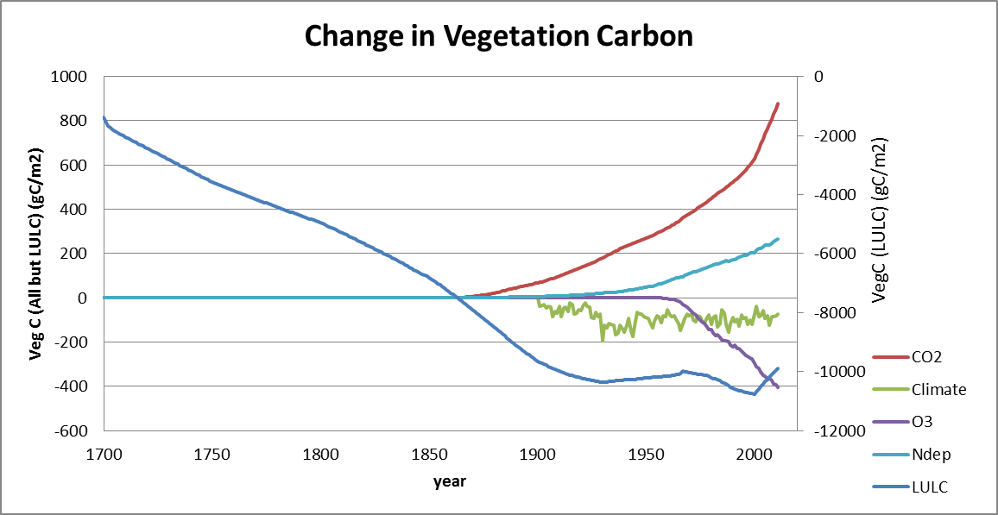
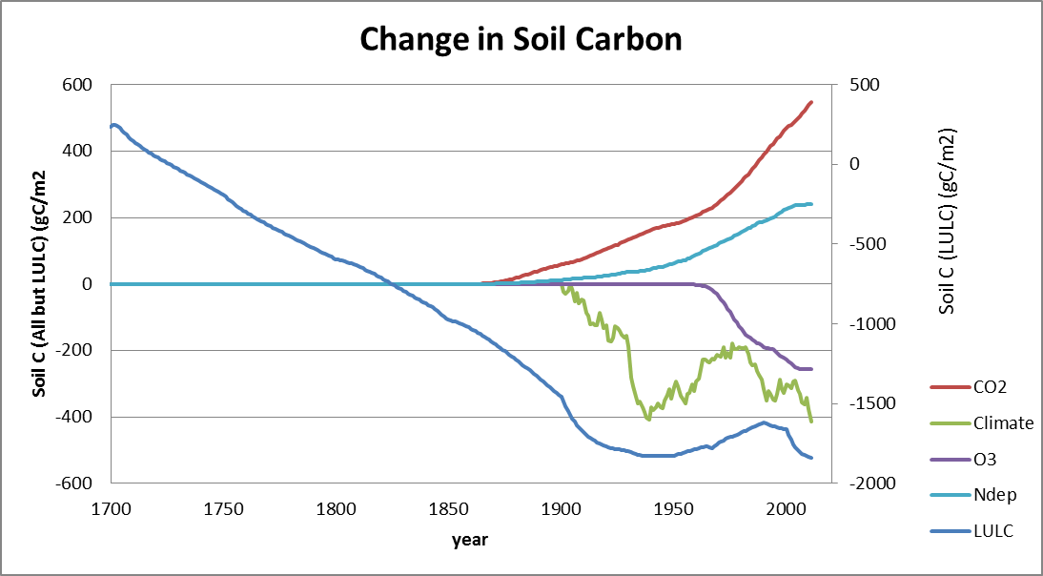

Slide 34
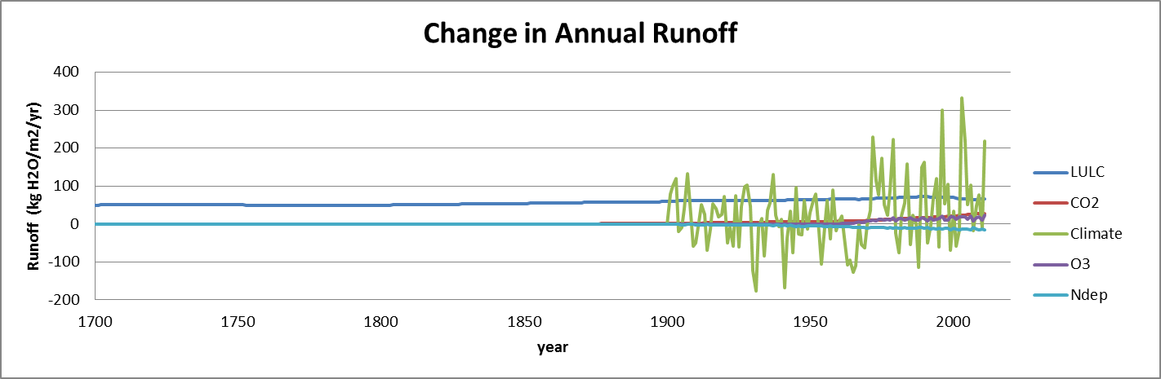

Slide 35
Feedbacks of Carbon on Water
Photosynthesis
Transpiration
Runoff
Elevated
CO₂
Nitrogen
limitation
positive coupling: amplifying
Ozone
exposure
negative coupling: dampening
Ball-Berry Model:
g_{c} = g_{min} LAI + g_{a} (GPP) (RH) / [CO₂]
Notes:
Figure 1: Effect of elevated CO₂, nitrogen limitation, and ozone exposure on runoff. Arrowheads are positive couplings; circles are negative couplings.

Slide 36
Key Results
Increased urbanization and climate change in PA results in more runoff while increased urbanization results in more DIN leaching
Useful to use future storm scenarios to determine enhanced flooding in local watersheds
Comparing models to eddy covariance data requires accounting for forest disturbance
Carbon storage has decreased due to LULC, climate, and ozone, but increased due to CO₂ and Ndep in the Mid-Atlantic since 1700
Runoff has increased due to LULC and slightly due to CO₂ and ozone
Model underestimating carbon sink?

Slide 37
Thanks!
M.S. Students: Shree Dangal
Ph.D. Students: Mingkai Jiang, Jien Zhang, Travis Andrews
Postdoc: Eungul Lee
Research Associate: Zavareh Kothavala
Undergraduates: Lauren Schneck, Cathy Withers, David Kolvek, Trista Barthol, Peter Phelps, Jonathan Chang
Co-Authors: T. Cronin, J. Melillo, D. Kicklighter, A. Schlosser, D. Sahagian, M. Hurteau
Assistance: B. Hargreaves, D. Morris, D. Sahagian
Funding Agencies: MIT, Westwind Foundation, Lehigh University, DOE (Basic Research and Modeling to Support Integrated Assessment), NSF (Macrosystems Biology).
Computational Time: NSF Yellowstone supercluster at Computational and Information Systems Laboratory (CISL)

Slide 38
EXTRA

Slide 39
(Felzer et al., 2012)
Notes:
Figure 1: TEM-Hydro Disturbance

Slide 40
TEM-Hydro Reduced Form Open Nitrogen
R_{h}
NonSymbiotic
Nfix
GPP
R_{a}
SOC
Soil Organic Matter
SOC
LtrN
VEGC
LtrC
SON
VEGN
Symbiotic
Nfix
NetNmin
DOCprod
DONprod
VegNup
DOC
DON
Ndep
AvailN
Fert.
LeachDOC
LeachDON
LeachDIN
(Felzer et al., 2012)
Notes:
Figure 2: TEM-Hydro Open Nitrogen Cycle. VEGC = total carbon in vegetation from stems, leaves, and roots, VEGN = total nitrogen in vegetation, SOC = soil organic carbon, SON = soil organic nitrogen, DOC = dissolved organic carbon, DON = dissolved organic nitrogen, AvailN = inorganic nitrogen, GPP = gross primary productivity, R_{a} = autotrophic respiration, R_{h} = heterotrophic respiration, NetNmin = net nitrogen mineralization, VegNup = uptake of inorganic nitrogen by vegetation, DOCprod = DOC production flux, DONprod = DON production flux, LeachDOC = DOC leaching flux, LeachDON = DON leaching flux, LeachDIN = leaching of Dissolved Inorganic Nitrogen.

Slide 41
TEM Inputs
Transient Datasets
Cloud or Radiation, Temperature, Precipitation, ozone, carbon dioxide (global annual value)
Vegetation cohorts
Static Datasets
soil texture, elevation
Parameter Files
soil, rooting depth, vegetation, vegetation mosaics, leaf, microbe, agriculture, calibrated biome files

Slide 42
TEM Calibration
Stocks
Vegetation Carbon, Vegetation Nitrogen, Soil Organic Carbon, Soil Organic Nitrogen, Soil Inorganic Nitrogen
Fluxes
NPP, N-saturated NPP, GPP, Plant Nitrogen Uptake
Parameters
CMAX (photosynthesis), NMAX (N uptake), KD (heterotrophic respiration), NUP (Net N mineralization), KR (autotrophic respiration)

Slide 43
Climate Data
Historical 20th century
CRU (Climatic Research Unit) 0.5º, monthly,1901-2009
PRISM (Parameter-elevation Regressions on Independent Slopes) 1/24º, monthly, 1890-2013
Future IPCC Scenarios
AR4: A2, (A1B, B1)
Downscaled/Bias-Corrected Surface Temperature and Precipitation CMIP3 (Maurer): 1/8º, monthly, 1950-2099
Delta/Ratio downscaling of Vapor Pressure and Net Irradiance

Slide 44
Carbon
Atmosphere
GPP
Rg
Rm
Rh
Vegetation
Leaf
Active Stem
Labile Pool
Allocation
Senescence
Root
Inactive Stem
LTRC
Soil
(Felzer et al, 2009, 2011)

Slide 45
Nitrogen
Vegetation
Leaf
Nresorb
Active Stem
Labile Pool
Allocation
Senescence
Root
Inactive Stem
VNUP
LTRN
Immobilization
Mineral
Organic
Mineralization
Soil
(Felzer et al, 2009, 2011)

Slide 46
Water
Shuttleworth-Wallace method
Screen height, known T, VPR
Canopy airspace, in contact with leaves and soil
Atmosphere
Surface of “big leaf”
Soil Surface
Transp.
Vegetation
canopy-to-screen height
aerodynamic resistance
Precip.
Transp.
leaf-to-canopy
aerodynamic
resistance
Soil Evap.
Soil Evap.
stomatal
resistance
soil-to-canopy
aerodynamic
resistance
Field Capacity
Runoff
Wilting
Point
soil internal
resistance
Soil: Bucket Model
(Felzer et al, 2009, 2011)

